Slide 1


UWP Workshop:
XAML
Dette er en test

Slide 2
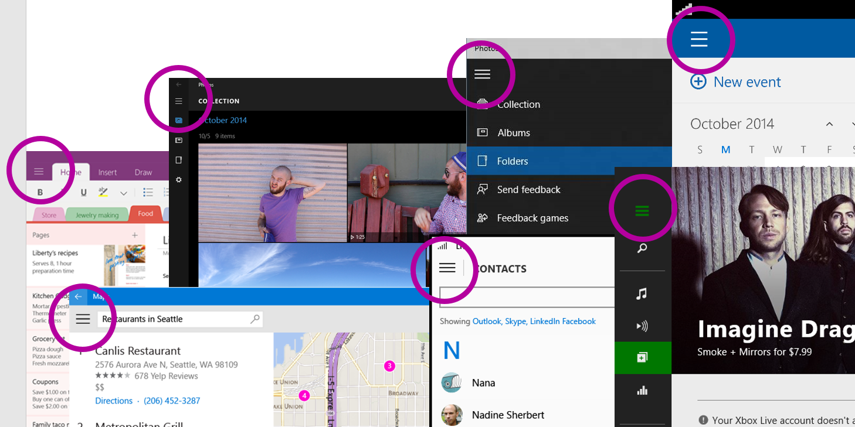
UWP Workshop – XAML
SplitView

Slide 3
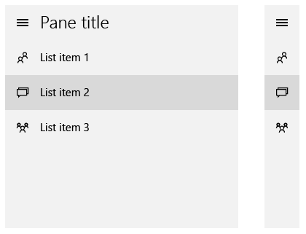
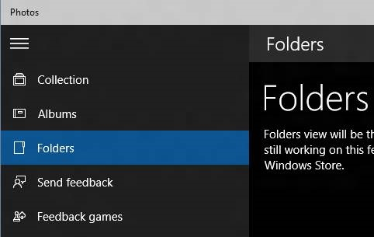
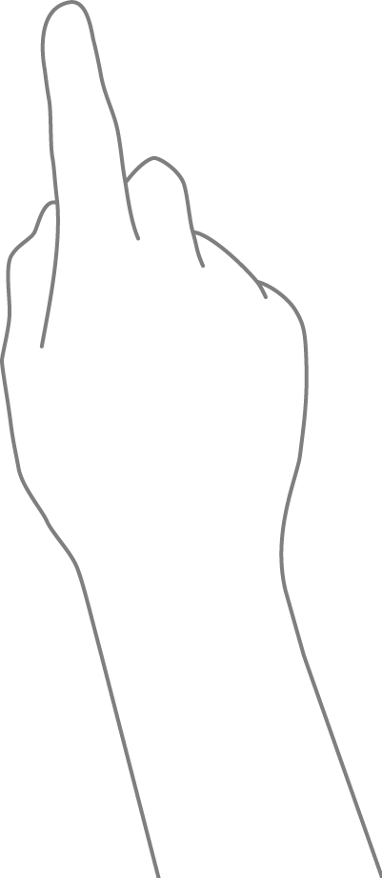
UWP Workshop – XAML
SplitView
Your Windows App

Slide 4
UWP Workshop – XAML
SplitView.Pane
<SplitView>
<SplitView.Pane>
<StackPanel>
<RadioButton />
<RadioButton />
</StackPanel>
</SplitView.Pane>
</SplitView>

Slide 5
UWP Workshop – XAML
SplitView.Content
Her placeres det egentlige indhold
<SplitView>
<SplitView.Pane />
<SplitView.Content>
<Frame/>
</SplitView.Content>
</SplitView>

Slide 6
UWP Workshop – XAML
SplitView properties
<SplitView
IsPaneOpen="False"
CompactPaneLength="150"
OpenPaneLength="50"
Placement="Right|Left"
PaneDisplayMode="CompactInline">
<SplitView.Pane />
<SplitView.Content />
</SplitView>

Slide 7
UWP Workshop – XAML
SplitView
Demo

Slide 8
UWP Workshop – XAML
RelativePanel

Slide 9
UWP Workshop – XAML
RelativePanel
<RelativePanel>
<Rectangle x:Name="RedRect" Height="100" Width="100" Fill="Red"
RelativePanel.AlignHorizontalCenterWithPanel="True" RelativePanel.AlignVerticalCenterWithPanel="True" />
<Rectangle x:Name="BlueRect" Height="100" Width="200" Fill="Blue" />
</RelativePanel>

Slide 10
UWP Workshop – XAML
RelativePanel
<Rectangle Height="100" Width="100" Fill=“Blue"
RelativePanel.AlignLeftWithPanel="True" (default)
RelativePanel.AlignRightWithPanel="True"
RelativePanel.AlignTopWithPanel="True" (default)
RelativePanel.AlignBottomWithPanel="True"
RelativePanel.CenterInPanelHorizontally="True"
RelativePanel.CenterInPanelVertically="True" />

Slide 11
UWP Workshop – XAML
RelativePanel
<RelativePanel>
<Rectangle x:Name="BlueRect" Height="100" Width="100" Fill="Blue" />
<Rectangle x:Name="RedRect" Height="100" Width="100" Fill="Red"
RelativePanel.RightOf="BlueRect" RelativePanel.AlignVerticalCenterWith="BlueRect" />
</RelativePanel>

Slide 12
UWP Workshop – XAML
RelativePanel
<RelativePanel>
<Rectangle x:Name="BlueRect" Height="100" Width="100" Fill="Blue" />
<Rectangle x:Name="RedRect" Height="100" Width="100" Fill="Red"
RelativePanel.Below="BlueRect" RelativePanel.AlignRightWith="BlueRect" />
</RelativePanel>

Slide 13
UWP Workshop – XAML
RelativePanel
<RelativePanel>
<Rectangle x:Name="BlueRect" Height="100" Width="100" Fill="Blue" />
<Rectangle x:Name="RedRect" Height="100" Width="100" Fill="Red"
RelativePanel.Below="BlueRect" RelativePanel.AlignHorizontalCenterWith="BlueRect" />
</RelativePanel>

Slide 14
UWP Workshop – XAML
RelativePanel
<RelativePanel>
<Rectangle x:Name="BlueRect" Height="100" Width="100" Fill="Blue" />
<Rectangle x:Name="RedRect" Height="100" Width="100" Fill="Red"
RelativePanel.Below="BlueRect" RelativePanel.AlignLeftWith="BlueRect" />
</RelativePanel>

Slide 15
UWP Workshop – XAML
RelativePanel
<Rectangle Height="100" Width="100" Fill="Red"
RelativePanel.Above="BlueRect"
RelativePanel.RightOf="BlueRect"
RelativePanel.Below="BlueRect"
RelativePanel.RightOf="BlueRect" />

Slide 16
UWP Workshop – XAML
RelativePanel
<Rectangle Height="100" Width="100" Fill="Red"
RelativePanel.AlignTopWith="BlueRect"
RelativePanel.AlignRightWith="BlueRect"
RelativePanel.AlignBottomWith="BlueRect"
RelativePanel.AlignLeftWith="BlueRect"
RelativePanel.AlignHorizontalCenterWith="BlueRect"
RelativePanel.AlignVerticalCenterWith="BlueRect" />

Slide 17
UWP Workshop – XAML
RelativePanel
Demo

Slide 18
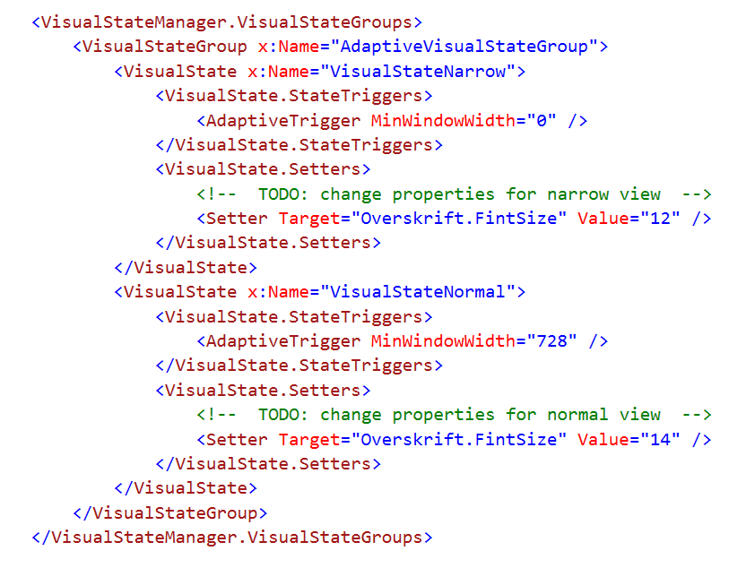
UWP Workshop – XAML
Adaptive triggers

Slide 19
UWP Workshop – XAML
Adaptive triggers
Demo

